Slide 1

Introduction
to Web
Development

Slide 2
What is Web Development

Slide 3

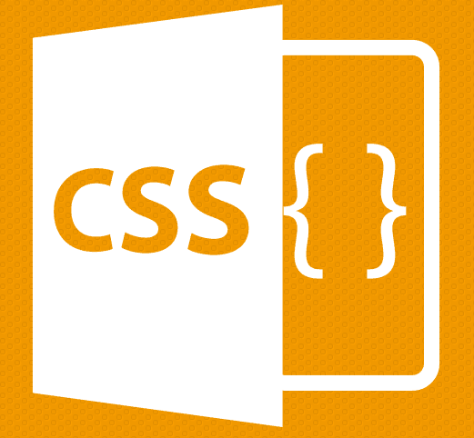


Forward today:
HTML
CSS
Live coding: Basic Layout Blog
Project: Google’s Homepage

Slide 4

HTML
Hypertext Markup Language
Notes:
1. HTML
2. Basic syntax
3. Tags
4. Basic Tags (html head body h1...h6 p div a button input img)
5. HTML Attributes
6. Attributes Syntax
7. Self closing tags (br input img)
8. class and ids

Slide 5
Syntax
<tagname>
</tagname>

Slide 6
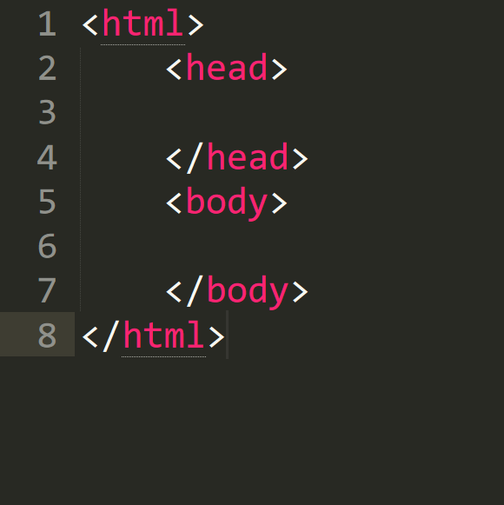
Syntax

Slide 7
<head> <title> Name of your page </title> </head>
<head> tags

Slide 8
<body> <h1> This is heading 1 </h1> <h2> This is heading 2 </h2> <h3> This is heading 3 </h3> <h4> This is heading 4 </h4> </body>
<body> tags

Slide 9
<img src=“images.jpg”> <a href=“https://www.google.com”> Whatever it takes </a>
<body> tags

Slide 10
<div> <p> <b> Welcome to Cyberlabs. </b> <i> Welcome to Cyberlabs. </i> <br> <u> Coding club of IIT (ISM), Dhanbad </u> </p> </div>
<body> tags

Slide 11
<div> <input type = “text”> </input> <button> “Click me” </button> </div>
<body> tags

Slide 12

CSS
Cascading Style Sheets

Slide 13
Syntax:
selector {
property-name: property-value;
}

Slide 14
<body> <h1 class=“header”> This is heading 1 </h1> <h2 class=“header” id=“my-id”> This is heading 2 </h2> <h3 class=“header”> </h3> <h4 class=“header”> </h4> </body>
Classes and IDs

Slide 15
color:
h1 {
color: red;
}

Slide 16
background-color:
h1{
background-color: green;
}
Notes:
Can use rgba() notation

Slide 17
background-image:
body {
background-image: url(image.jpg);
background-size: cover;
}

Slide 18
font:
p {
font-family: “Times New Roman”, Times, serif;
font-style: italic;
font-size: 30px;
font-weight: bold;
}

Slide 19
Width and Height:
p {
height: 200px;
width: 50%;
}

Slide 20
border:
p {
border: 3px solid blue;
border-radius: 10px;
}

Slide 21

box-model:

Slide 22
padding:
p {
padding-top: 50px;
padding-right: 30px;
padding-bottom: 50px;
padding-left: 80px;
}
p {
padding: 50px 30px 50px 80px;
}

Slide 23
margin:
p {
margin-top: 50px;
margin-right: 30px;
margin-bottom: 50px;
margin-left: 80px;
}
p { margin: 50px 30px 50px 80px;
}

Slide 24
Live Coding I:
Basic Blog
Layout

Slide 25
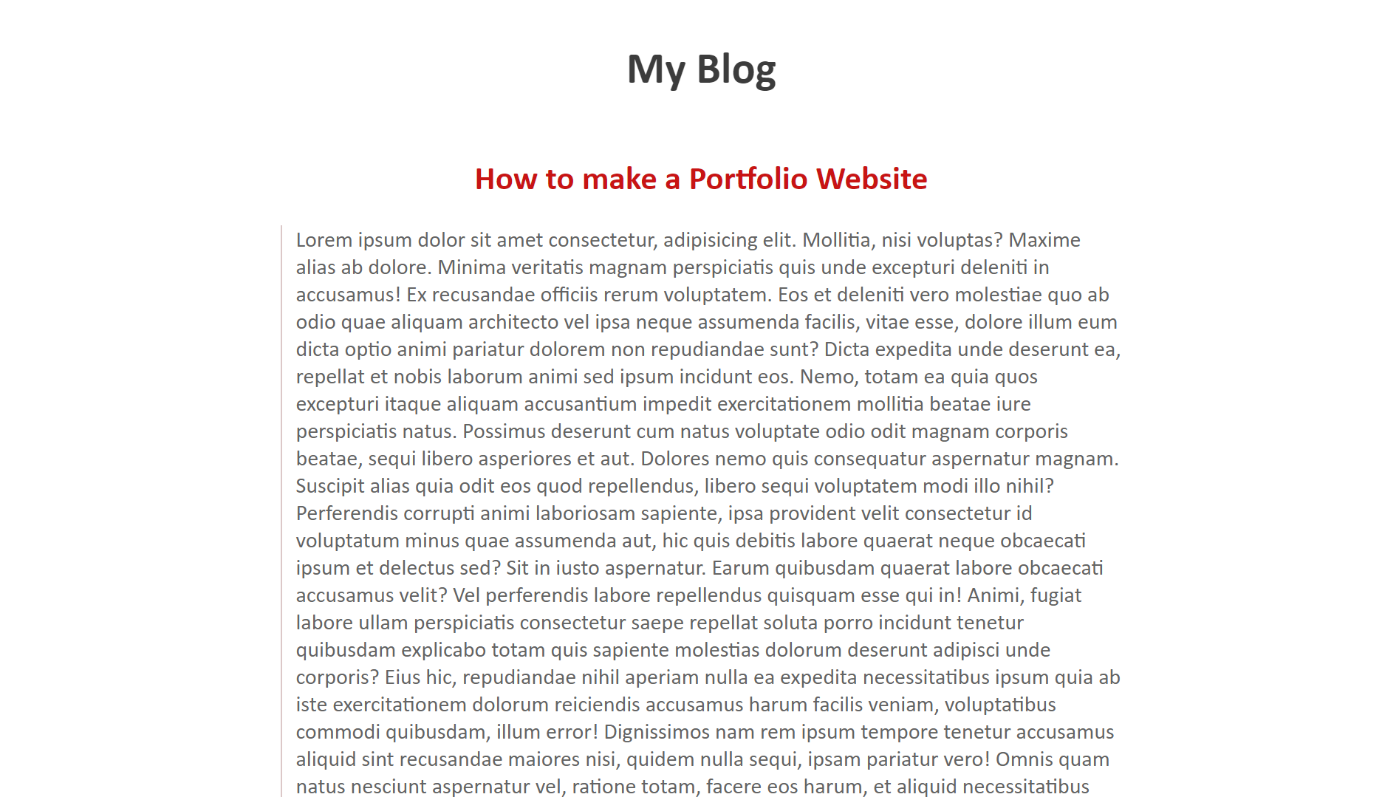
What we will make

Slide 26
Project for You people:
Google’s
Homepage Clone

Slide 27
First we will write down the basic structure of an HTML page
<html>
<head>
<title> Homepage</title>
</head>
<body>
</body>
</html>

Slide 28
The Next comes header .Our header consist of navbar having list with two links and a sign In button.
<header>
<nav>
<ul id="nav_bar">
<li class="nav_links"><a href="#">Gmail</a></li>
<li class="nav_links"><a href="#">Images</a></li>
<li id="sign_in"><a href="#">Sign In</a></li>
</ul>
</nav>
</header>

Slide 29
Now let’s add some css to our header.
body{
margin: 0;
padding:0;
font-family: 'Lucida Sans', 'Lucida Sans Regular',
'Lucida Grande', 'Lucida Sans Unicode', Geneva, Verdana, sans-serif;
}
header{
width: 100%
}
ul{
list-style: none;
}

Slide 30
a{
text-decoration: none;
color: inherit;
}
#nav_bar{
float: right;
}
#nav_bar li{
display: inline-block;
padding: 8px;
}

Slide 31
.nav_links{
text-decoration: underline;
}
#sign_in{
background-color: dodgerblue;
color:white;
font-weight: 600;
margin: 25px;
padding: 7px 15px;
border-radius: 3px;
}

Slide 32
Next Comes an image tag.
<div class="google">
<a href="#" class="google_link">
<img src="http://i1381.photobucket.com/albums/ah2 15/mzartdesigns/google-logo_zpspkcztsjo.png" alt=" photo google-logo_zpspkcztsjo.png"/>
</a>
</div>

Slide 33
Here is the CSS to our image.
.google .google_link{
text-align: center;
display: block;
margin-top:200px;
clear: both;
margin-bottom: 20px;
}

Slide 34
Now we have to add search-bar to our google homepage.
<div class="form">
<form>
<input type="text" id="input" placeholder="Type your search here..." />
</form>
</div>

Slide 35
Here comes the CSS to our search-bar.
.form{
text-align: center;
}
#input{
padding:20px;
width:400px;
}

Slide 36
Last thing we are left with is two buttons
Google search and I’m feeling lucky
<div class="button">
<input type="submit" value="Google search">
<input type="submit" value="I'm feeling lucky">
</div>

Slide 37
A simple CSS applied to our buttons
.button{
text-align: center;
margin:20px;
}

Slide 38
Thank you

